Slide 1
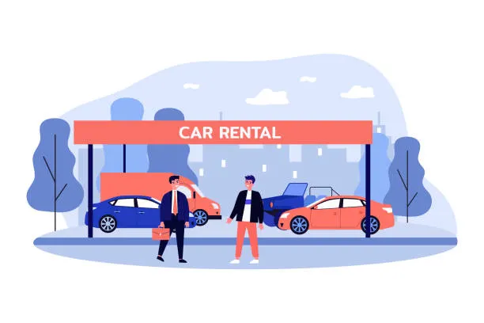
DriveShare
Short-term Vehicle Rental Service
By: Meaad Hassan, Hussain Albaghdady and Eman Swaydan

Slide 2
Introduction
DriveShare is a car rental platform that connects vehicles owners with renters.
Car owners can list vehicles and earn income
Renters can search and book cars
In-app messaging between hosts and renters
Notifications for watchlist/rentals
Secure session management and password recovery

Slide 3




Features to be demonstrated
1
User Registration and login
2
Vehicle search and booking
3
Owner Dashboard
3
4
Messaging system
5
Payment
6
Rental history

Slide 4
6 Patterns implemented
Singleton
Observer
Proxy
A session manager pattern that tracks logins, and pervents problems
Watchers notifications and when price drops or vehicles become available
A proxy to validate before going into reservation
Builder
Mediator
Chain Of Resp.
Constructs and list the vehicles
It helps the UI coordinate dates, filters, selections and pricing
Security questions of a chain to make sure the site is secure

Slide 5
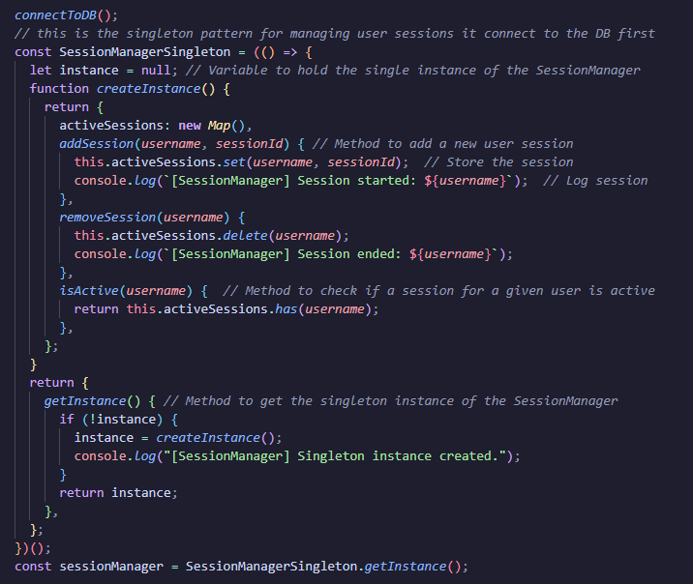
Pattern 1- Singleton
Session Manager
Guarantees only one session for a user
Tracks active logins
Private instance cannot be made twice
Verified:

Slide 6
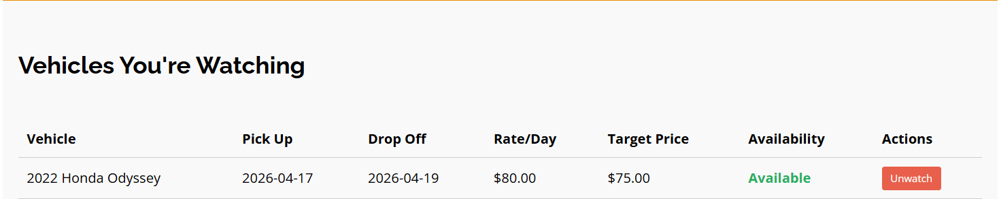
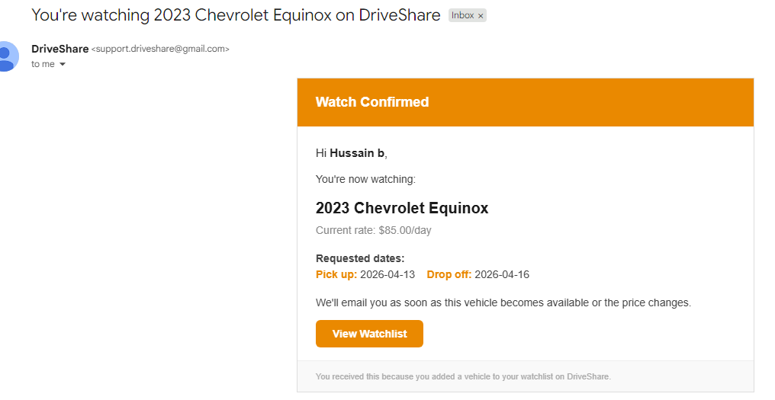
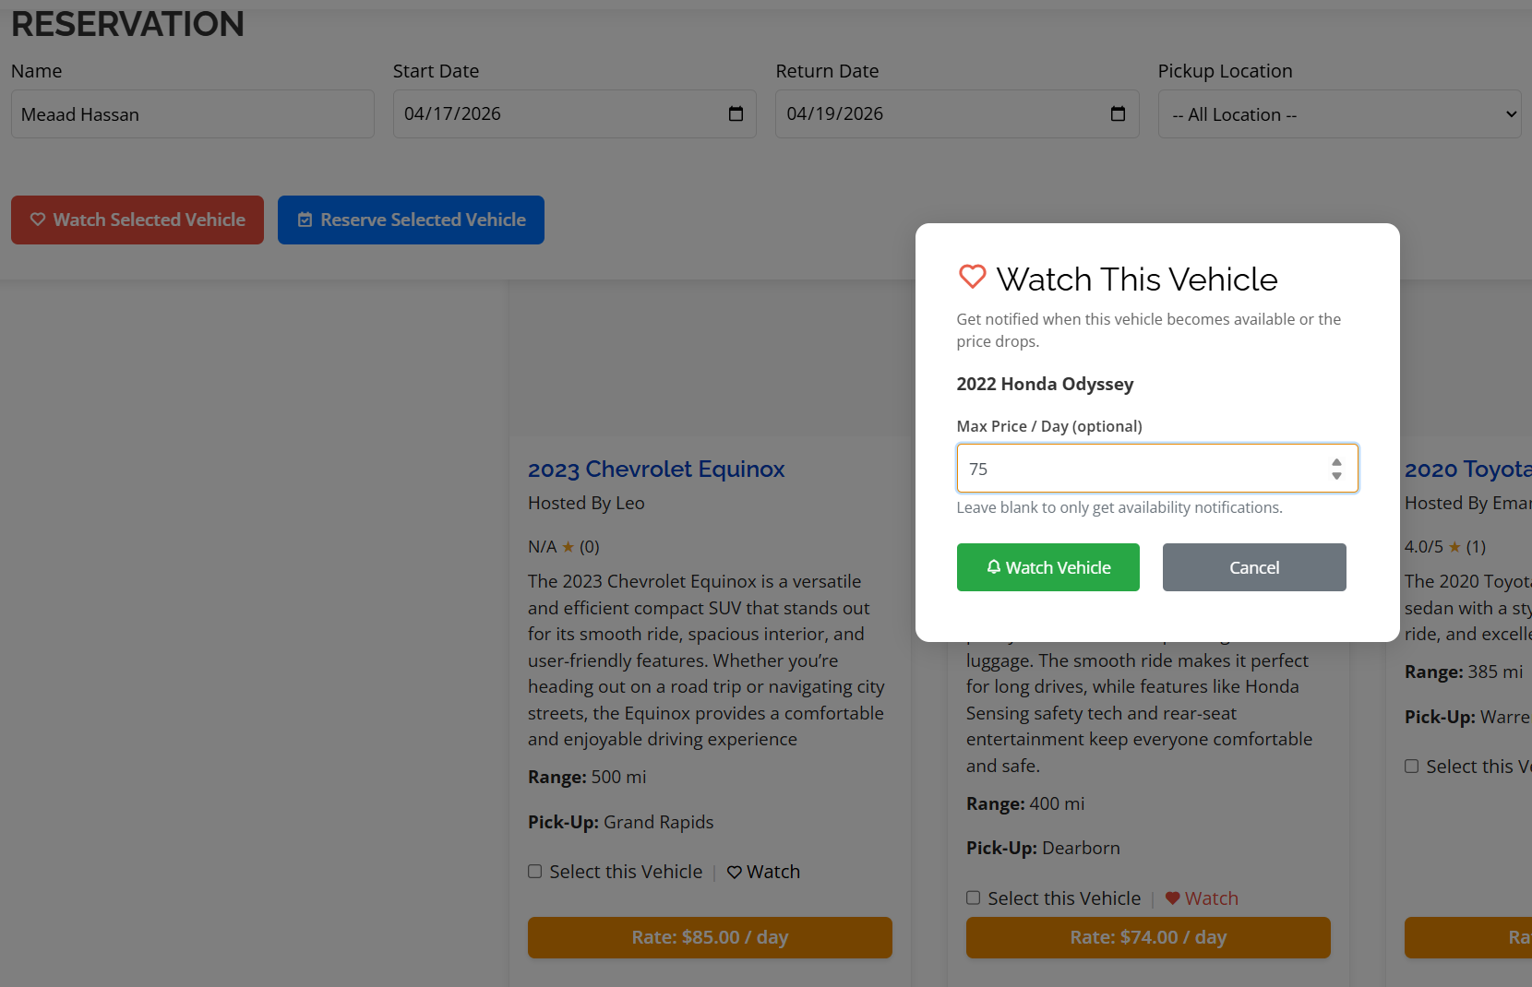
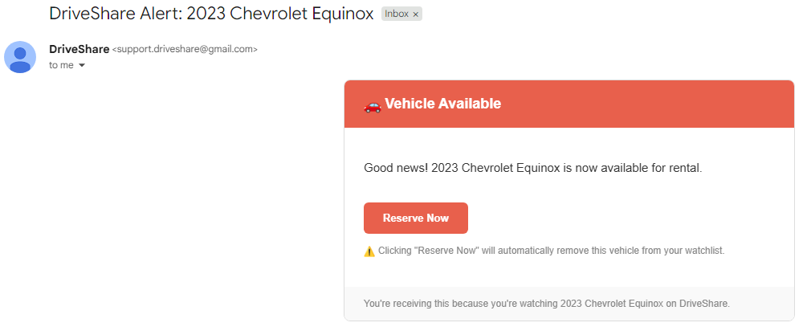
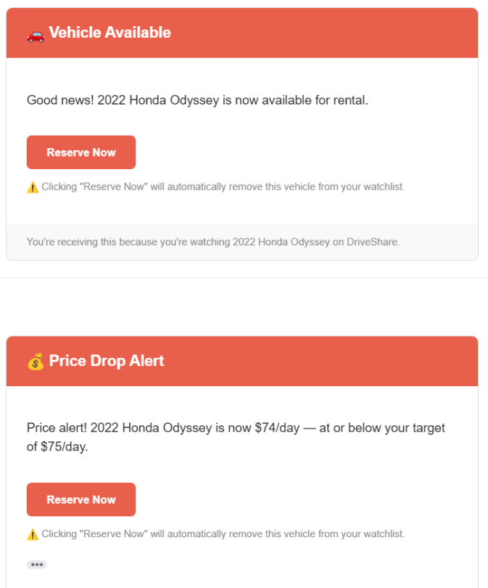
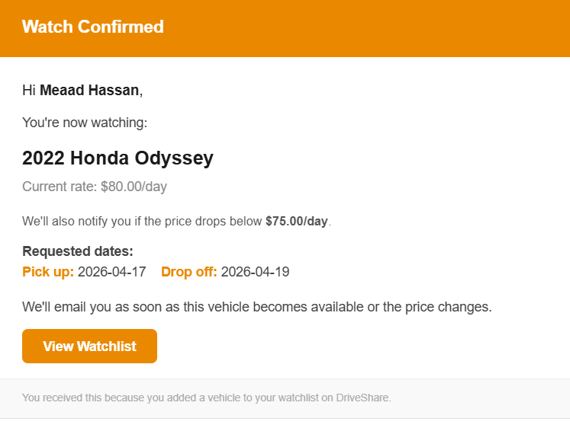
Pattern 2- Observer
Watches for notifications
Checks vehicles every 60 seconds to notify if it is available
Sends email
Verified:

Slide 7
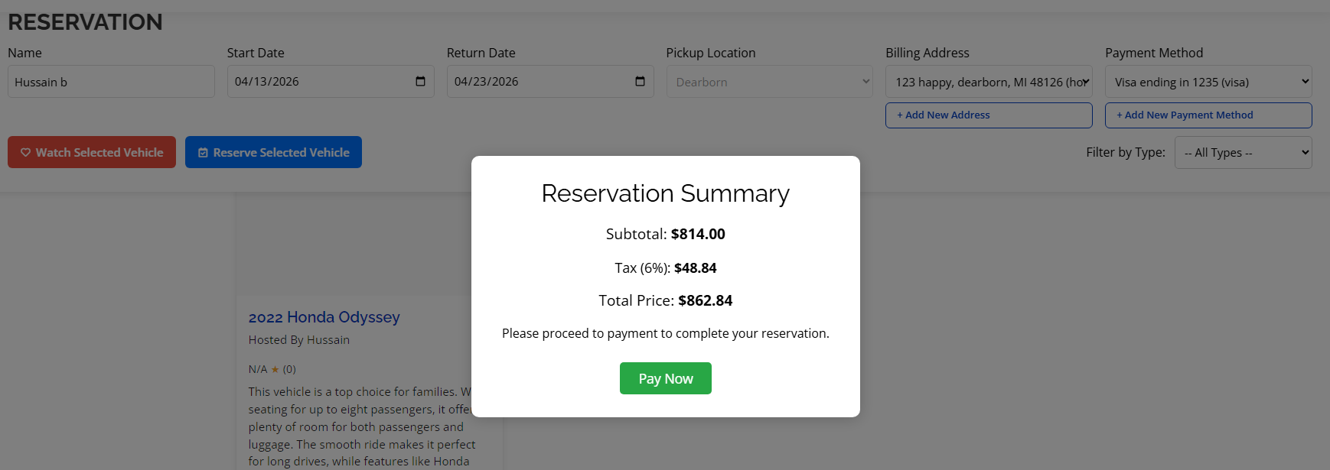
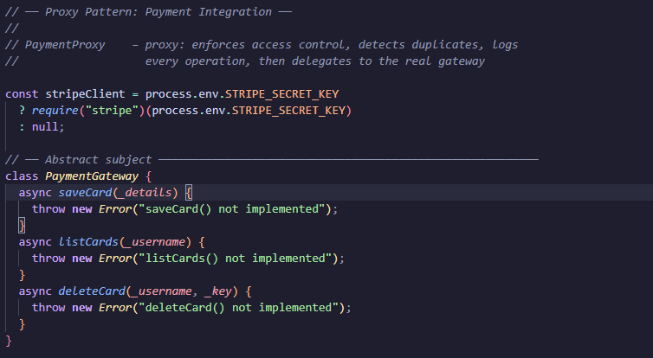
Pattern 3 and 4 - Mediator and Proxy
Coordinates For UI (mediator)
Proxy Pattern
Coordinates all UI components though one cernteral object and pattern
They dont interact with each other so its more efficient
Checks vehicle before processing
Validates payments
Confirms dates
Verified:
Verified:

Slide 8
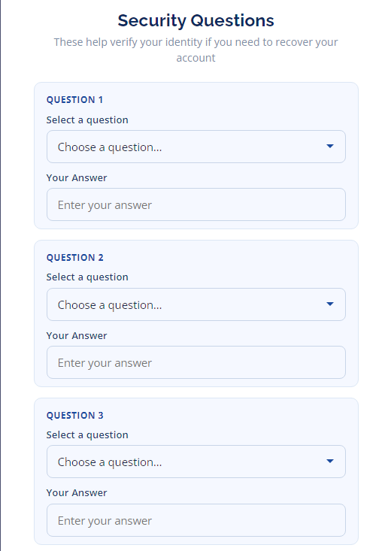
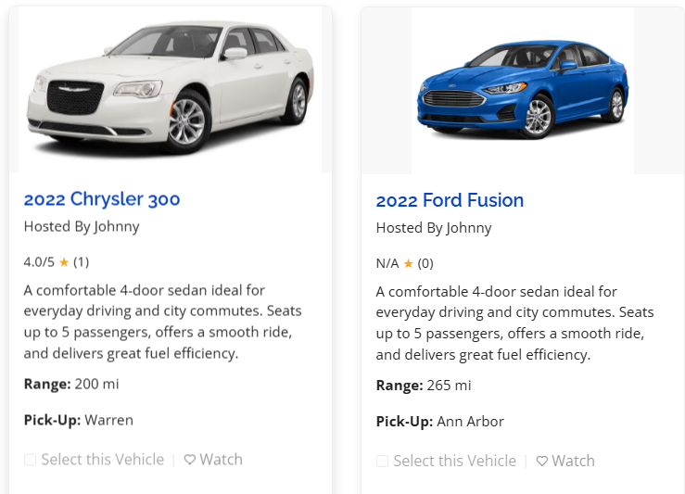
Pattern 5 and 6 - Builder and Chain of Responsibility
Constructs vehicle listing objects
Security questions to form a chain of responsibility
Sets category pricing and location so a user can pick between the m
Sets up the details for the vehicle objects
To make sure everything is secure and ensure theres security
Passes thought chains of handlers and process each one sequentially
Verified:
Verified:

Slide 9
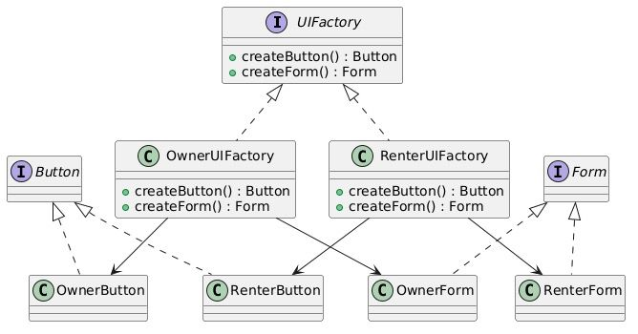
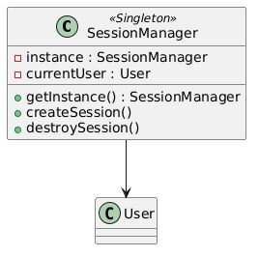
Diagrams made for DriveShare:

Slide 10
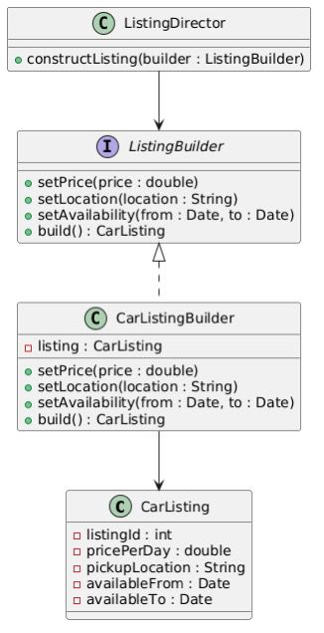
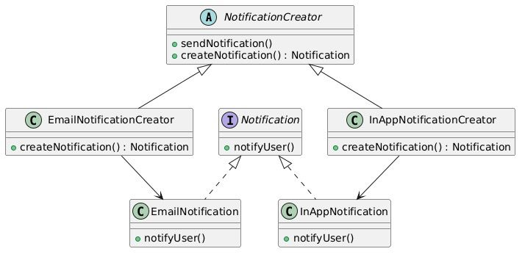

Slide 11
TASK SUMMARY
Who Built What
Task
Details
By
User Registration & Auth
Registration, forget password
Meaad Hassan
Login / Logout / Session
express-session, role-based redirect , SessionManager
Meaad Hassan
Vehicle Listing (Owner)
Add/edit/delete vehicles, Builder pattern
All members
Login instance
Singleton, Observer pattern, diagrams
Hussain Albaghdady
Vehicle Search & Booking
Date filter, vehicle cards , Mediator, Proxy payment
All members
Watchlist & Notifications
Helped with Observer pattern, Diagrams
Eman Swaydan
Messaging System
Send message to host,email notification,inbox/sent
Meaad Hassan
Password Recovery
Chain of Responsibility, 3 security questions , reset
Eman Swaydan
Database & Seed Data
MongoDB Atlas, 5 hosts, 30 vehicles
Meaad Hassan
Notifications
email confirmations and watch notifications
Hussain Albaghdady

Slide 12
Thank You!

